Slide 1

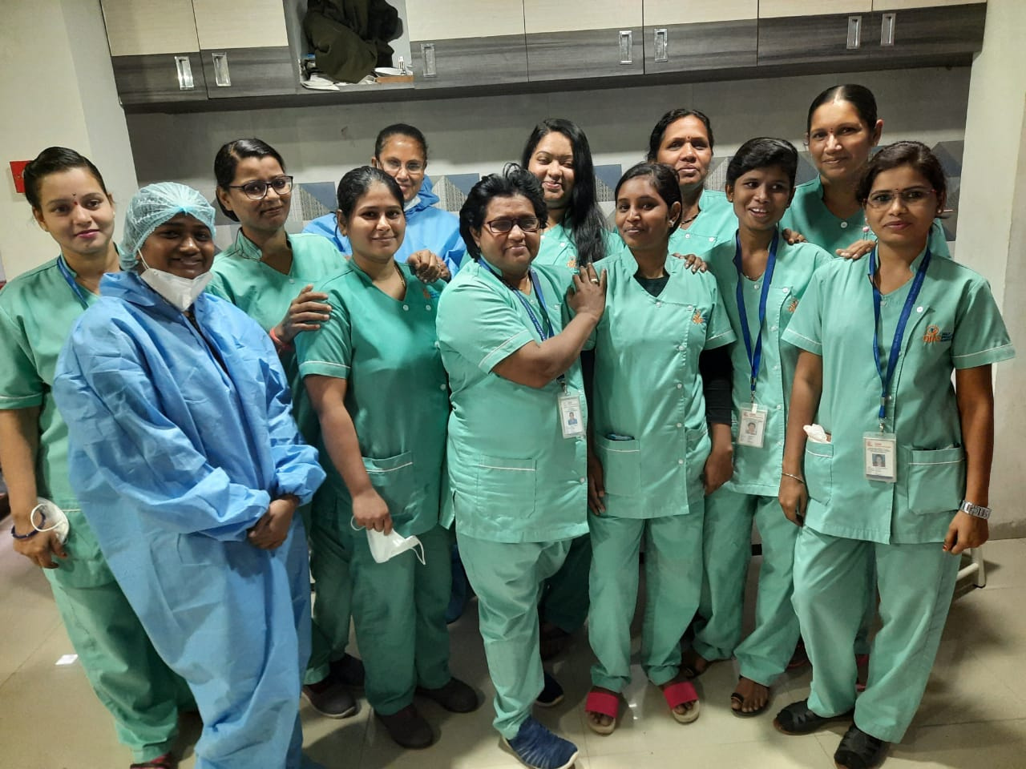


UNDERSTANDING THE NURSING PROCESS
A Comprehensive Guide to the Core of Effective Nursing Care

Slide 2




01
What is the Nursing Process?
Definition
“The nursing process is a systematic, patient-centered, and goal-oriented approach to providing quality nursing care”
  Focuses on addressing patient needs
  Based on critical thinking and evidence-based practice

Slide 3

02
Steps of the Nursing Process
  Assessment: Gathering comprehensive patient data.
  Diagnosis: Identifying health issues based on data.
  Planning: Setting measurable goals and interventions.
  Implementation: Executing the care plan.
  Evaluation: Assessing the effectiveness of interventions.

Slide 4

03
Characteristics of the Nursing Process
  Systematic and organized.
  Patient-centered.
  Dynamic and adaptable.
  Goal-oriented and result-driven.
  Based on critical thinking

Slide 5

04
Nursing Assessment Process
  Definition:
The first step involves collecting and organizing data about the patient’s physical, emotional, and psychological health
  Steps:
Data collection, validation, and documentation.

Slide 6
05
Purpose of the Nursing Process
  To deliver holistic and individualized care.
  To enhance communication between healthcare providers.
  To achieve better patient outcomes.
  To ensure continuity of care

Slide 7

06
Planning in the Nursing Process
Definition:
  Developing a patient-specific care plan to achieve desired outcomes.
Key Components:
  Prioritizing nursing diagnoses.
  Setting SMART goals (Specific, Measurable, Achievable, Relevant, Time-bound).
  Choosing appropriate interventions

Slide 8

07
Evaluation in the Nursing Process
Definition:
  The final step to determine the effectiveness of the care plan.
Steps:
  Analyze the patient’s response to interventions.
  Compare outcomes with goals.
  Modify care plans as needed

Slide 9

08
Nursing Diagnosis
Definition:
  Identifying the patient’s health issues based on assessment data.
Types:
  Actual diagnoses.
  Risk diagnoses.
  Health promotion diagnoses.
Importance:
  Guides targeted interventions

Slide 10



THANK
YOU
9156567152
https://mahealthfoundation.in
MA Health Care Foundation,
Jankar Residency, Shiv Shambho Colony,
Adarsh Nagar Rd, Kiwale, Ravet, Pimpri-Chinchwad,
Pune, Maharashtra 412101

