Slide 1




CARE OF DEATH & DYING PATIENT
Guidelines, Procedures, and Best Practices

Slide 2




01
Introduction
Caring for a dying patient is about ensuring comfort, dignity, and emotional support during the final stages of life.
It involves managing physical symptoms, addressing emotional needs, and supporting the family.
At MA Health Care Foundation, we specialize in end-of-life care with trained professionals to provide compassionate support.

Slide 3

02
Physical Care
  Pain Management: Administering medications to alleviate discomfort.
  Symptom Control: Managing nausea, fatigue, and breathing difficulties.
  Hygiene Care: Ensuring cleanliness and comfort with gentle handling

Slide 4

03
Emotional Support
  Active listening to address fears and anxieties.
  Providing companionship to reduce feelings of loneliness.
  Encouraging family interaction and creating meaningful moments

Slide 5

04
Role of Caregivers
  Physical Care: Assistance with mobility, hygiene, and daily tasks.
  Monitoring: Observing and reporting changes in condition.
  Communication: Acting as a bridge between medical staff and family.
  Companionship: Offering emotional presence to reduce feelings of isolation

Slide 6




Family Support
Dignity in Death
  Educating families on what to expect during the dying process.
  Offering guidance on practical matters, such as caregiving techniques.
  Emotional counseling to cope with grief and loss
  Respecting patient wishes and cultural values.
  Providing a calm and peaceful environment.
  Encouraging meaningful rituals and farewells

Slide 7



Spiritual and Psychological Care
Spiritual Care: Supporting patients and families with their spiritual or religious needs
Psychological Support: Reducing anxiety and stress for patients and caregivers
Grief Counseling: Preparing families for loss and offering coping strategies

Slide 8

05
Why Choose MA Health Care?
  Affordable and reliable services for end-of-life care.
  Professional team with 15+ years of experience.
  Personalized care plans to suit individual needs

Slide 9
05
Conclusion
Providing Comfort When It Matters Most
Caring for a dying patient is about offering not just medical support, but emotional, spiritual, and compassionate care.
At MA Health Care, we focus on preserving dignity, alleviating pain, and ensuring comfort during the final stages of life

Slide 10
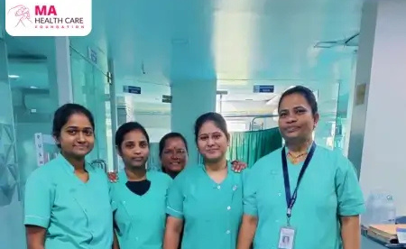



THANK
YOU
9156567152
mahealthfoundation.in
MA Health Care Foundation,
Jankar Residency, Shiv Shambho Colony,
Adarsh Nagar Rd, Kiwale, Ravet, Pimpri-Chinchwad,
Pune, Maharashtra 412101

