Slide 1




CARE OF UNCONSCIOUS PATIENT
Guidelines, Procedures, and Best Practices

Slide 2




01
Introduction
Definition of unconsciousness
Loss of awareness and responsiveness to external stimuli
Causes
Head injury, stroke, drug overdose, hypoglycemia, infections, etc

Slide 3

02
Objectives of Care
  Maintain airway, breathing, and circulation (ABC).
  Prevent complications like pressure sores and infections.
  Ensure patient safety and dignity

Slide 4

03
Initial Assessment (ABCs)
  Airway: Ensure it is open (use head tilt-chin lift or jaw thrust).
  Breathing: Check for adequate ventilation.
  Circulation: Monitor pulse and blood pressure

Slide 5




Positioning the Patient
Airway Management
  Place the patient in the recovery position (if unconscious but breathing).
  Ensure the head is turned to the side to prevent choking from vomit.
  Avoid spinal movement if a neck injury is suspected
  Suction secretions to keep the airway clear.
  Insert an oropharyngeal or nasopharyngeal airway if necessary.
  Monitor oxygen saturation; provide oxygen if required

Slide 6

Monitoring and Vital Signs
Nursing Care
  Skin care:
    Turn patient every 2 hours to prevent pressure sores.
  Mouth care:
    Clean mouth and keep it moist.
  Nutrition:
    Provide enteral feeding via an NG tube if required.
  Urine and bowel care:
    Monitor output and prevent infections
  Continuous monitoring:
    Heart rate, blood pressure, respiratory rate, and oxygen levels.
  Neurological checks:
    Use GCS to track consciousness level over time.
  Look for signs of deterioration (pupil changes, irregular breathing).

Slide 7

04
Preventing Complications
  Infections: Use aseptic techniques.
  Aspiration: Position properly and monitor feeding.
  Contractures: Perform passive range-of-motion exercises.
  Deep vein thrombosis (DVT): Apply compression stockings and encourage mobility if possible

Slide 8



Psychological Support
Talk to the patient even if they appear unresponsive
Involve family members in the care process
Maintain a calm and positive environment

Slide 9
05
Conclusion
    Maintain ABCs.
    Prevent complications.
    Provide holistic care to support recovery.
    Importance of teamwork in patient care

Slide 10
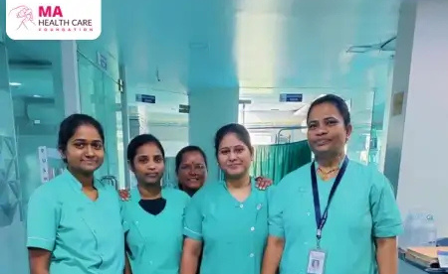



THANK
YOU
9156567152
mahealthfoundation.in
MA Health Care Foundation,
Jankar Residency, Shiv Shambho Colony,
Adarsh Nagar Rd, Kiwale, Ravet, Pimpri-Chinchwad,
Pune, Maharashtra 412101

